Slide 1
F1 Race data analysis and BOSTON AIRBNB DATA ANALYSIS
Data Warehouse and Business Intelligence
-Meet Vasani, Mihir Kakadiya

Slide 2
F1 Race data problem statement AND Expected OUTPUT
Formula 1, spanning from 1950 to 2017, holds a rich dataset encompassing various aspects of racing ( i.e. drivers, teams, circuits, race results and many more). The challenge is to extract valuable insights and optimize strategies which can help make the game more efficient, make any future improvements.
The project aims to provide teams, analysts, and enthusiasts with actionable insights derived from historical Formula 1 data. This includes improved decision-making strategies, optimized car setups, and a deeper understanding of the factors influencing success in one of the world's premier racing championships.

Slide 3
Data Warehouse MODEL

Slide 4
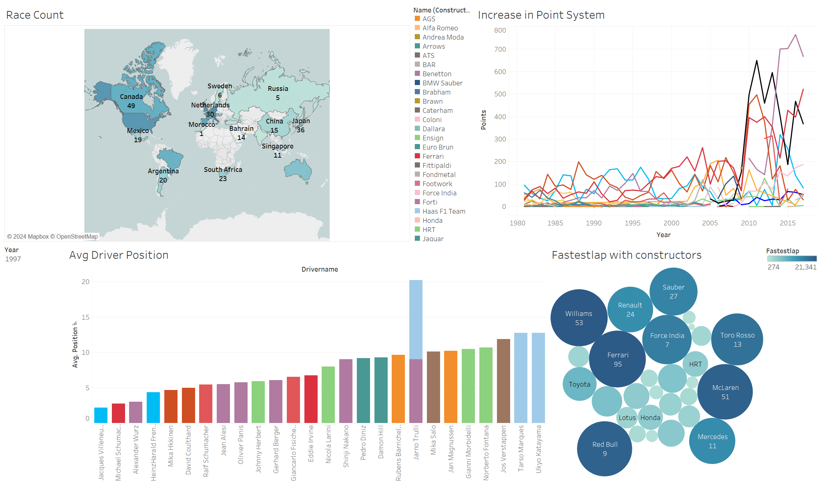
Dashboard

Slide 5
Boston Airbnb problem statement AND Expected OUTPUT
The Boston Airbnb dataset contains a wealth of information regarding property listings, hosts, price and guest reviews. However, this raw dataset lacks structure and organization, making it challenging for hosts, guests, and analysts to extract actionable insights and optimize strategies to enhance experiences and performance in the hospitality industry.
The project aims to analyze the Boston Airbnb dataset, structuring it into tables for efficient data management. Through geographical and price analysis, insights will be gained into property trends and pricing dynamics.

Slide 6







AWS Data Pipeline architecture diagram
Data loaded to Glue using Lambda by trigger.
Data loaded to S3.
Performed ETL transformation and stored transformed data into S3.
Loaded data to Athena for SQL
queries.
Data from S3 loaded to
Crawler.
Connected Tableau with Athena to gain insights.

Slide 7
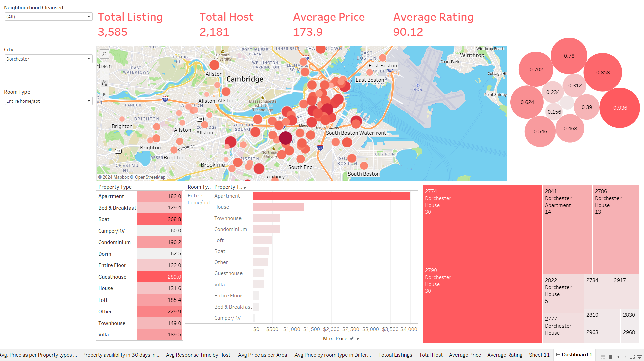
Dashboard

Slide 8
Thank you

